Slide 1

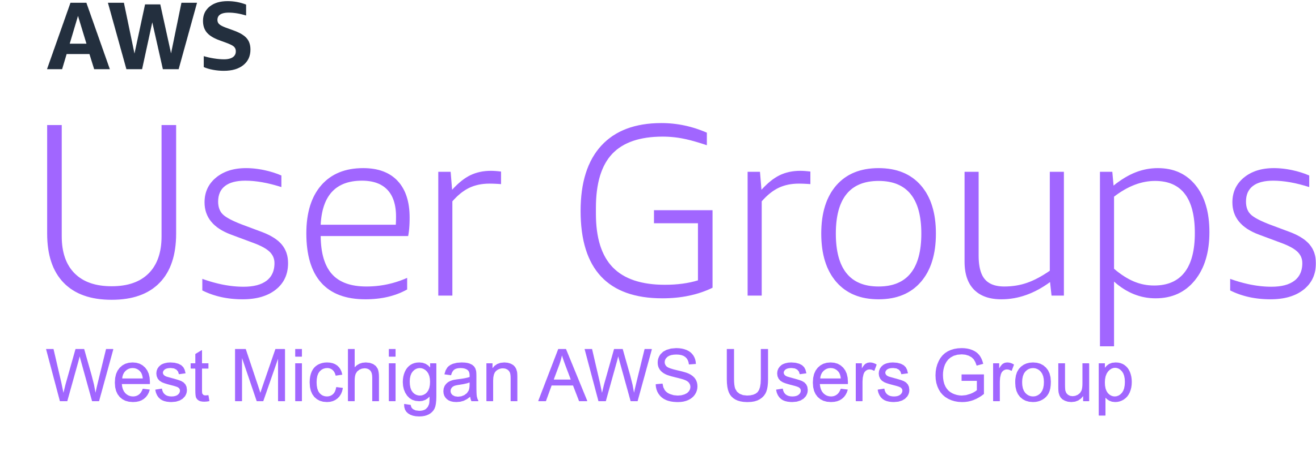

Automating Pull Requests With
CDK & BedRock
March 2024

Slide 2


Introductions
Trent Nielsen
Justin Wheeler
Enterprise Architect @ PXG
Cloud consultant
Husband and Father
Software Developer @ Bravo LT
Cloud Builder
Holder of all the certs

Slide 3
User Group Updates
New Organizer
2024 Schedule
User Group AWS Account(s)
AWS Account Credit Raffle

Slide 4
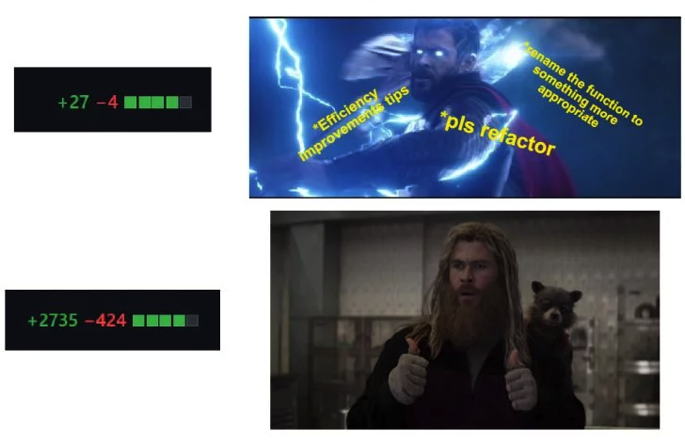

Slide 5
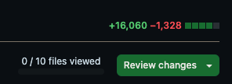
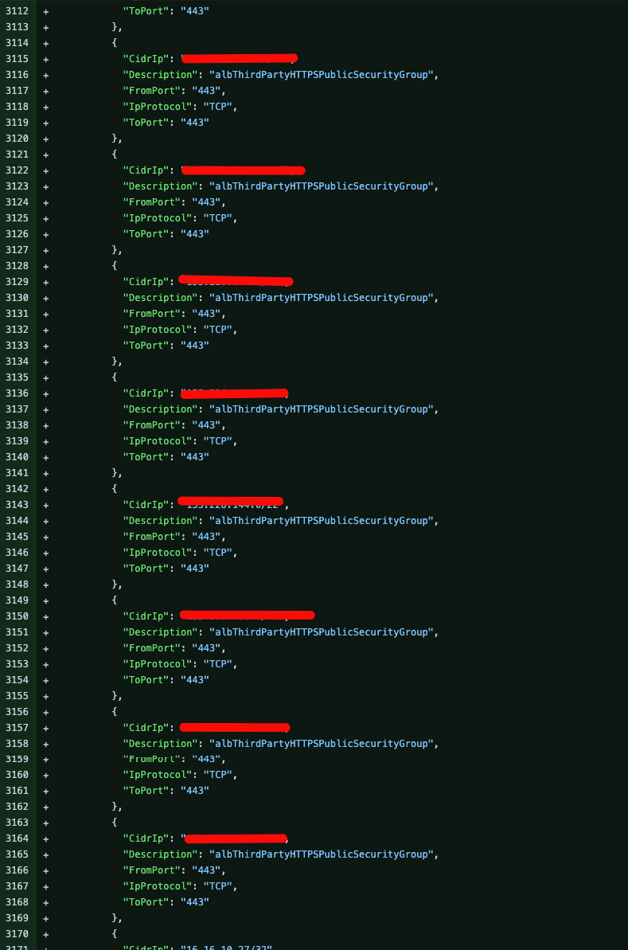
Look Familiar?

Slide 6
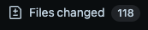
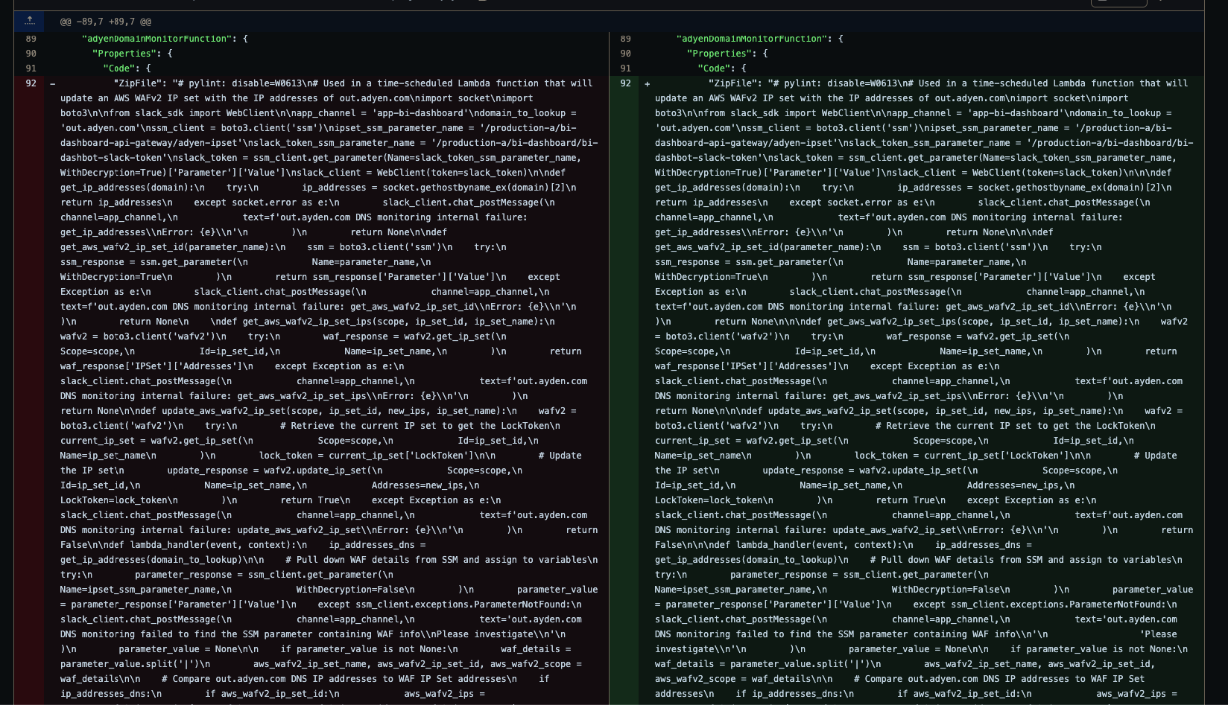
Look Familiar?

Slide 7
PR Problems
Time-consuming, especially for routine changes
Unintended changes can be missed in large PRs
Automatically summarize changes
Automatically nitpick for style/formatting issues

Slide 8
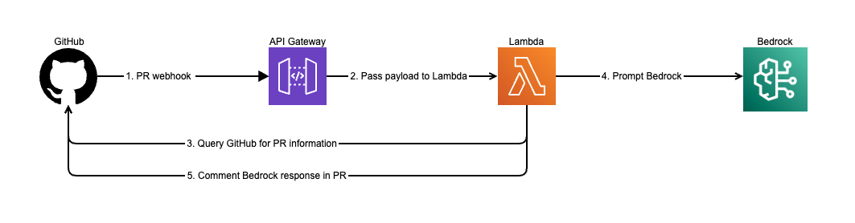
Architecture

Slide 9
CDK Placeholder

Slide 10
CDK Things that go here
Architecture Review
CDK project language
DRY
Imperative
Layout
Assets
Lambda
Layers
AWS Supported

Slide 11
CDK Resource Info
API gateway
Lambda

Slide 12
Alternative overview
- Lambda URL as alternative

Slide 13
App Logging
- API Gateway can be enabled for access logs
- Enabled for Lambda execution logs
- Bedrock prompts are logged

Slide 14
Bedrock
Claude Model access – must be requested in the console, no provisioned resources required.
Proposed solution used Claude 2.1

Slide 15

GitHub

Slide 16

More than just a code repo
Actions
WebHooks
Secrets

Slide 17
Actions Automation
Build Environment
Install AWS-CDK
Setup Python
Configure AWS credentials
Build Assets
Layer
Lambda
CDK Synth
CDK Deploy

Slide 18
Webhooks
Configured Per Repo
Event Triggers
Enabled for PrBot

Slide 19
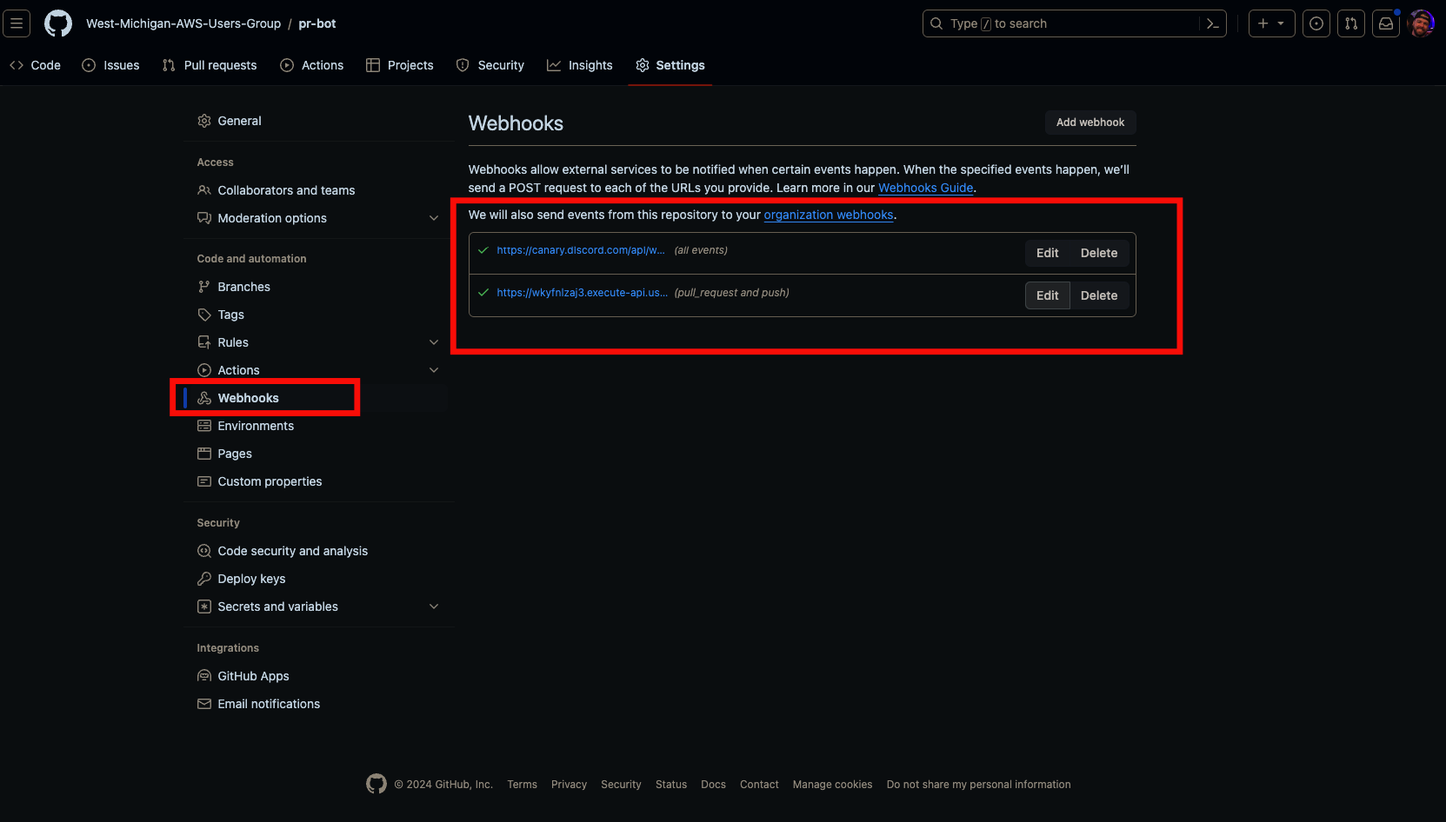
Webhooks

Slide 20
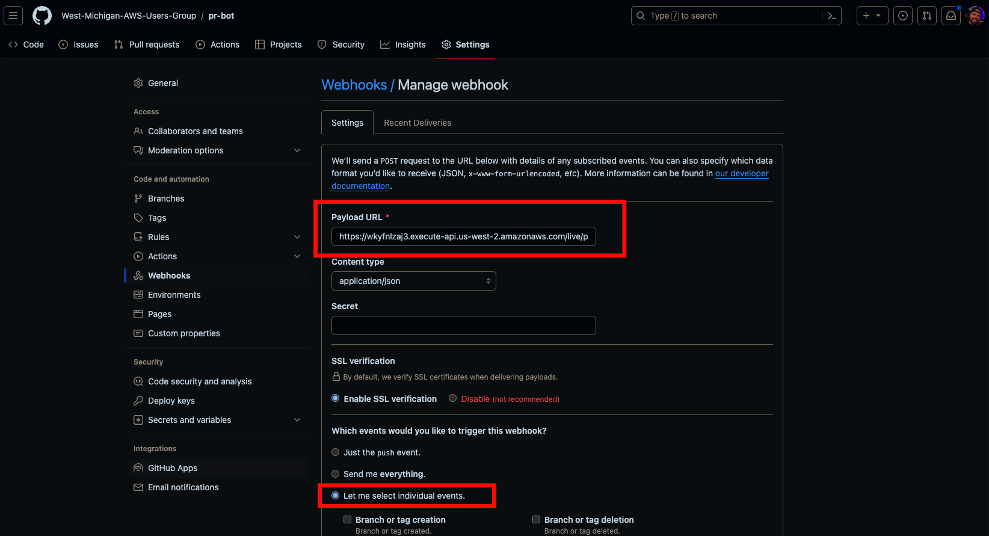

Slide 21
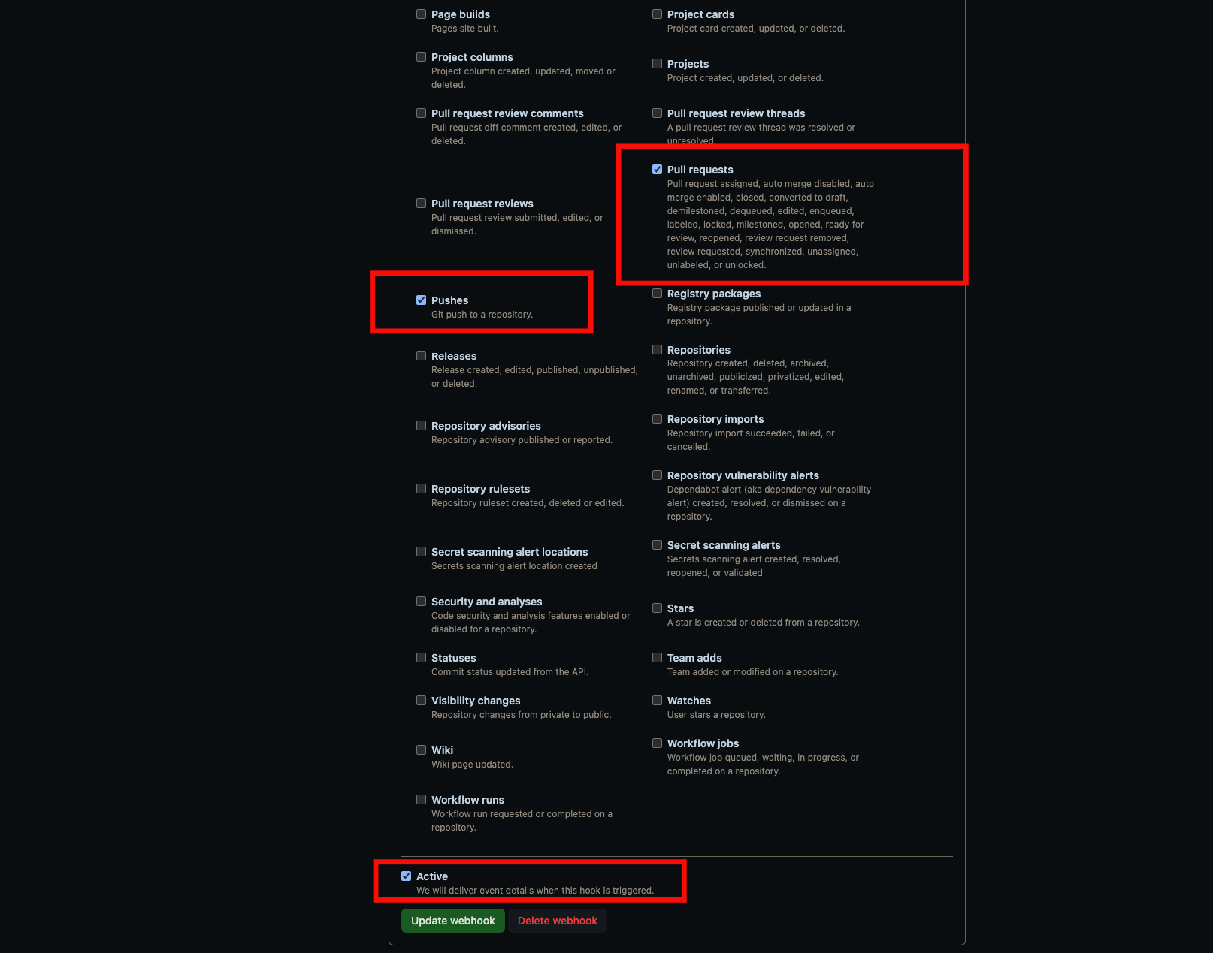

Slide 22
Secrets
Deploy user
Github Token

Slide 23
CI Secrets
Service Account Keys
This provides deploy keys for Actions
Configured in GitHub

Slide 24
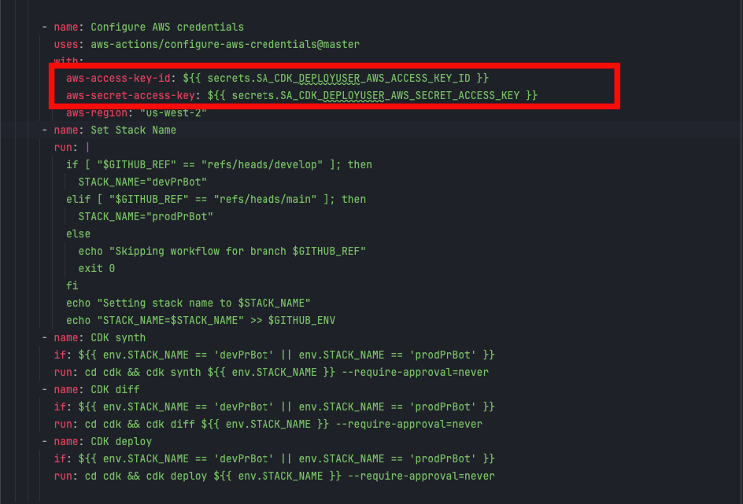
CI Secrets

Slide 25
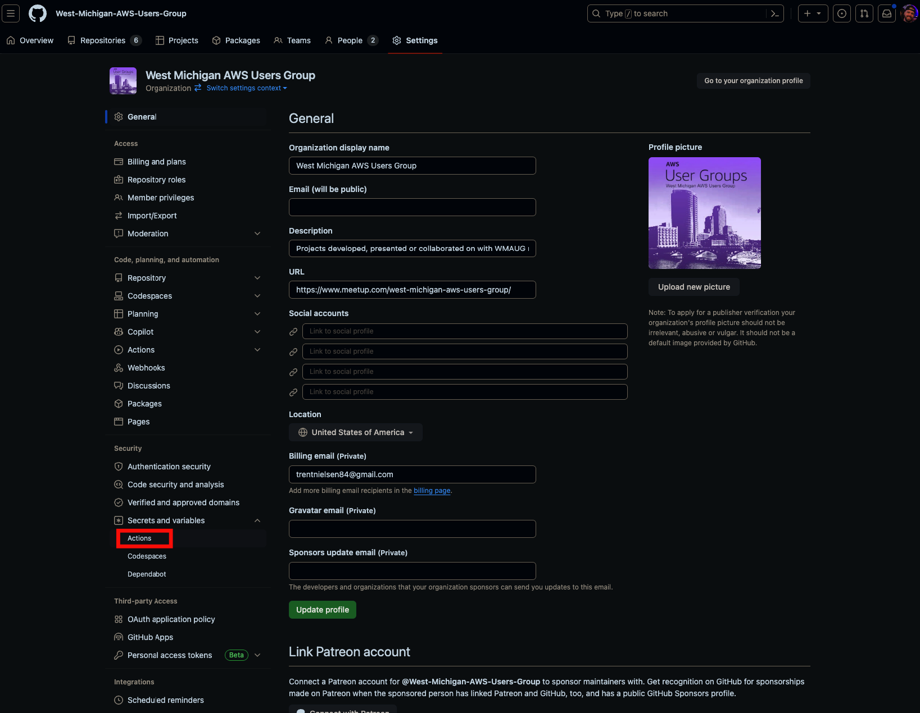

Slide 26
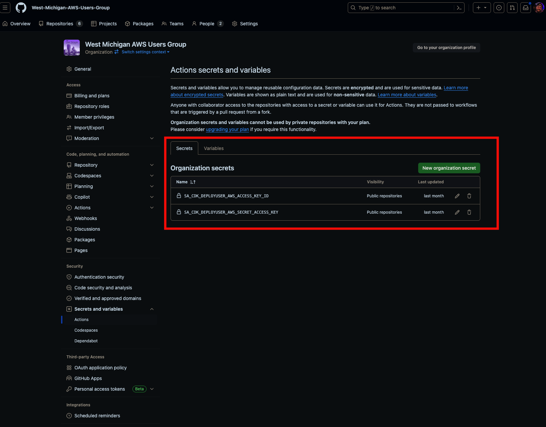
Secrets

Slide 27
App Secrets
AWS Secrets
Code Reference

Slide 28
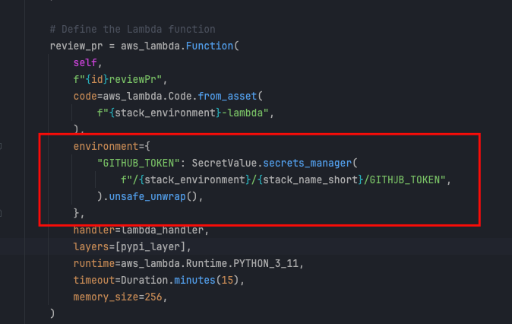
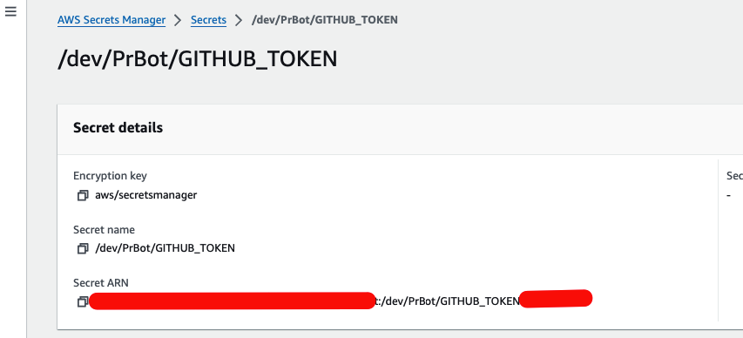
App Secrets

Slide 29
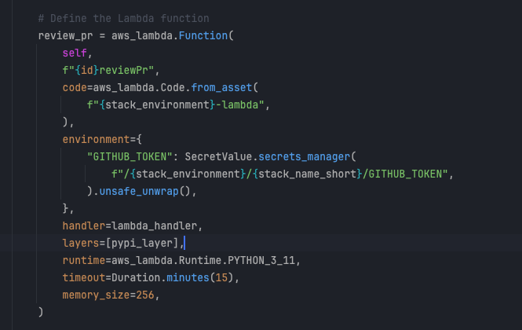
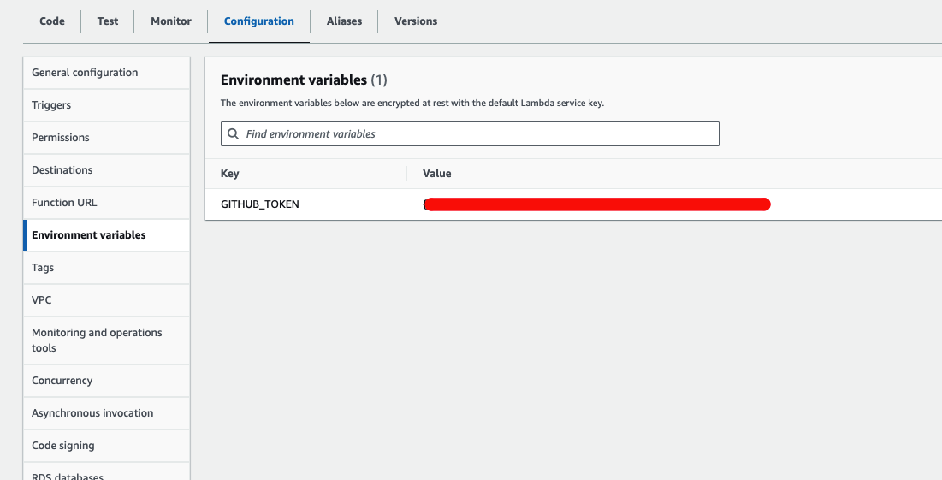
Secrets (Unsafely Unwrapped)

Slide 30
Actions Config Review

Slide 31

Lambda + Bedrock Code Review

Slide 32
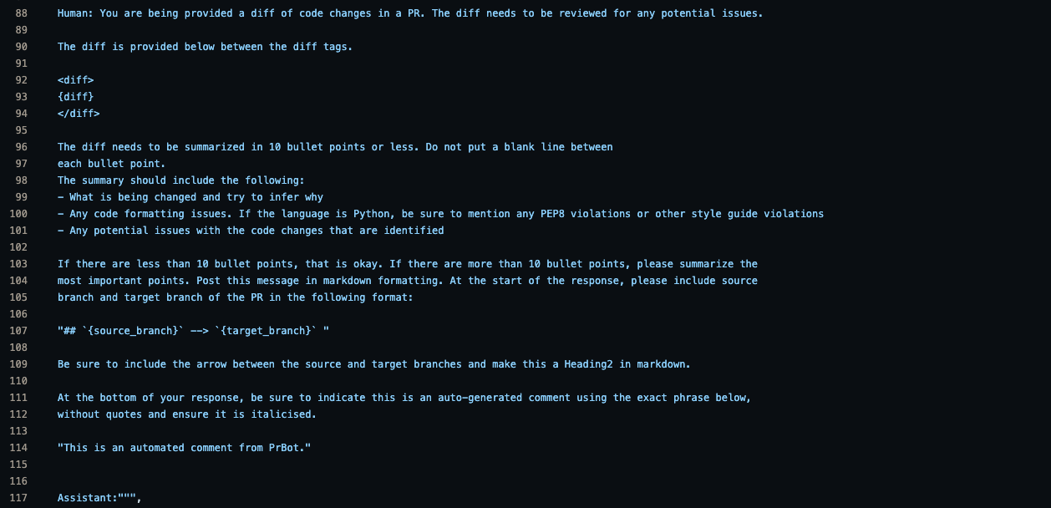
Prompt

Slide 33
Examples

Slide 34
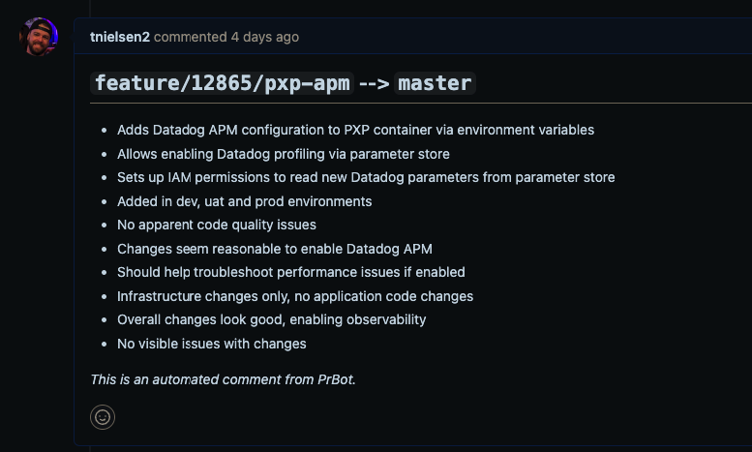
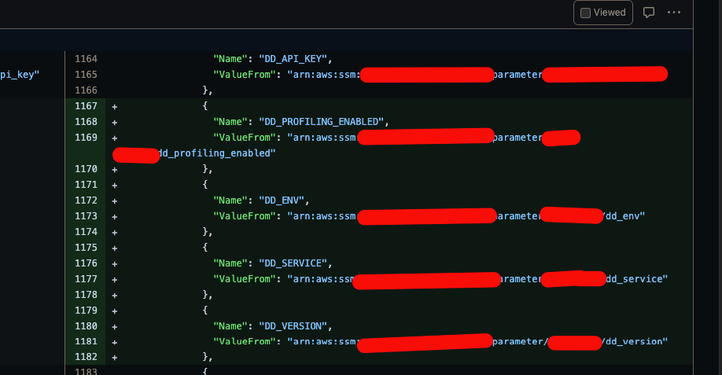
Add Environment Variables

Slide 35
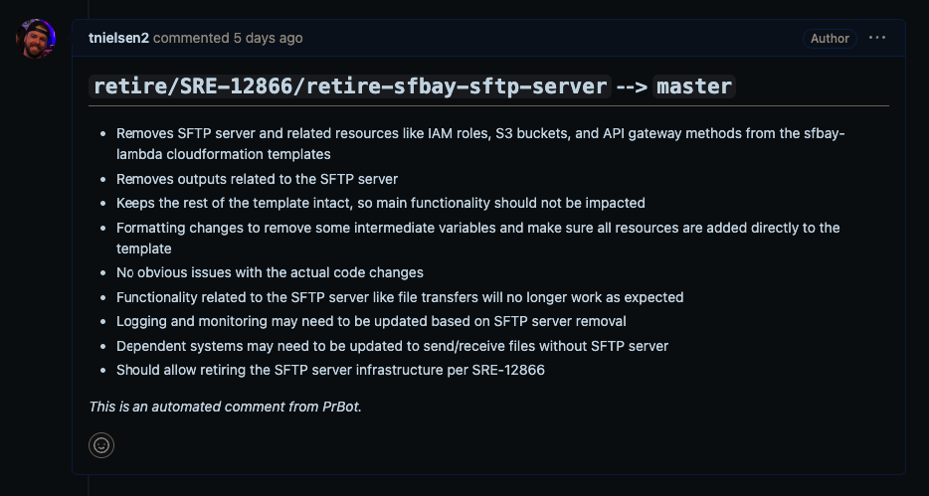
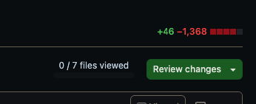
Stack Retirement

Slide 36
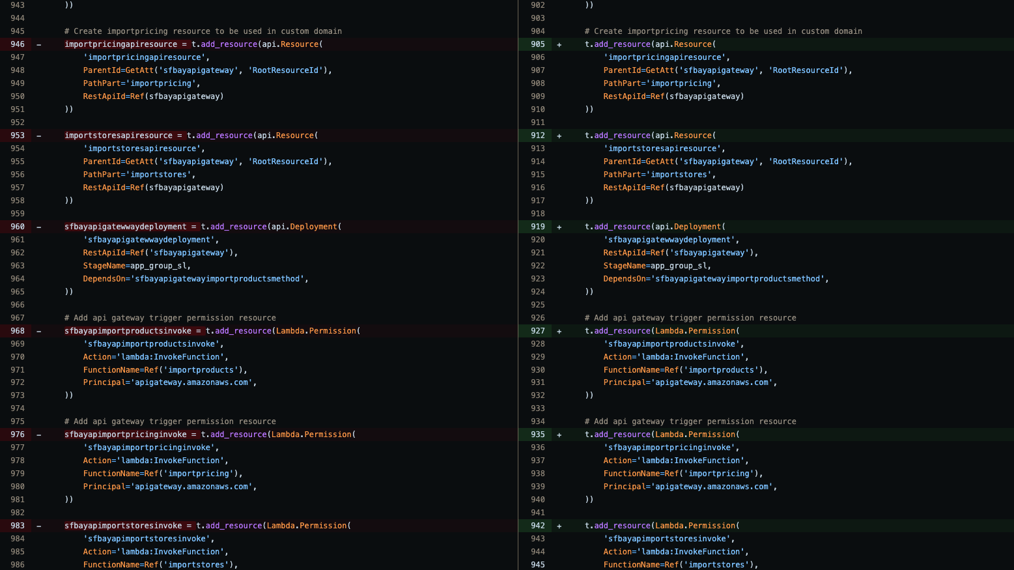
Stack Retirement (Continued)

Slide 37
Title Slide
Cost
AWS User Groups
37

Slide 38
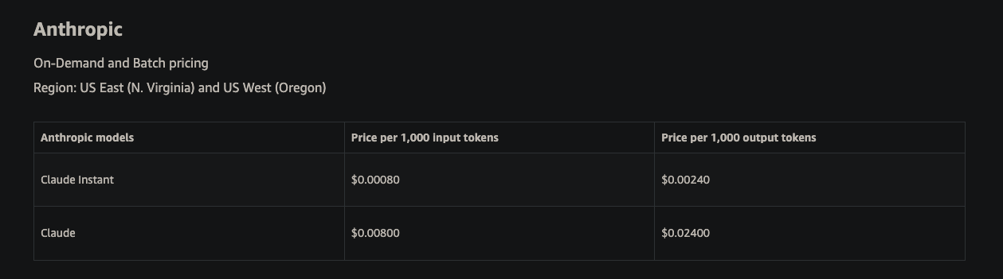
Cost

Slide 39
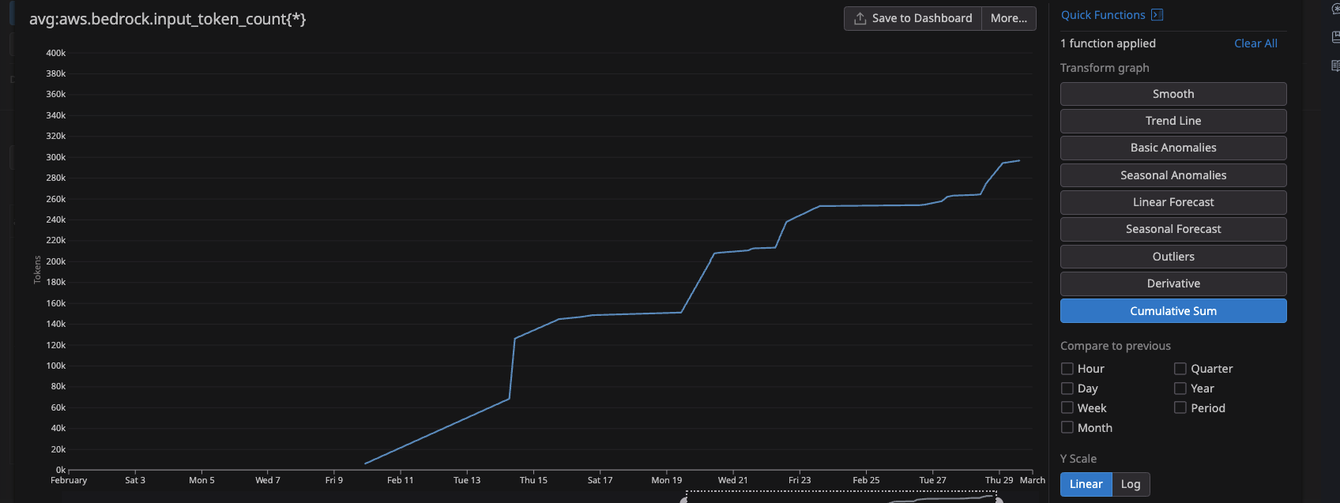
Usage

Slide 40
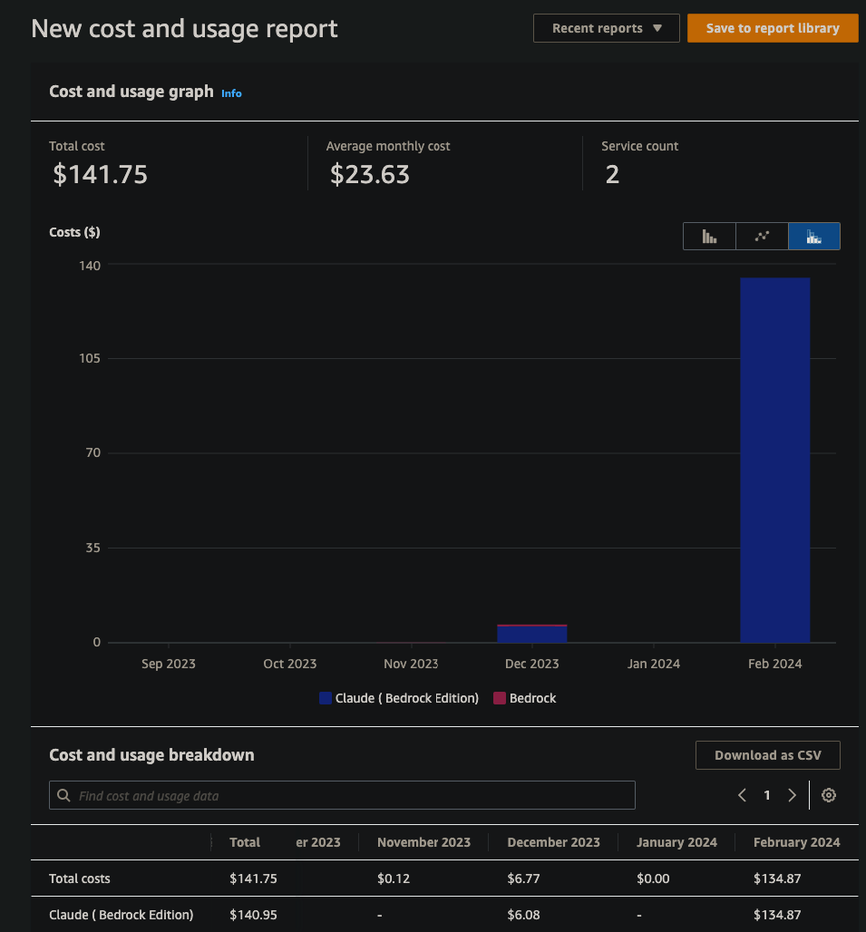
Cost

Slide 41
Title Slide
Improvements
AWS User Groups
41

Slide 42
Improvements
Layer
Layer build process and version pinning
Unique per environment for future testing
Pin to known good versions to prevent unexpected layer changes
Tests
Implement CDK tests
Permissions
Migrate personal access token to service-account user
Trigger on
Trigger on-demand w/ label usage, rather than on every PR
Update
Update CDK to have Lambda fetch values from Secrets instead of injecting as an environment variable
Auto
Auto-tagging after approval (for 2x auto-reviewer tagging)

Slide 43

Current
PrBot
Upcoming
Betrayal Buddy
WMAUG Website
WMAUG AWS Account Infrastructure rollout

Slide 44
Title Slide
Raffle
import random def select_random_index(string_list): if not string_list: print("Error: The list is empty.") return None random_index = random.randint(0, len(string_list) - 1) selected_string = string_list[random_index] return random_index, selected_string my_string_list = ["Trent", "Justin", "Darth", "Luke", "Chewy"]
random_index, selected_string = select_random_index(my_string_list) print(f"Randomly selected index: {random_index}: {selected_string}")
AWS User Groups
44

Slide 45
Title Slide
Questions ?
AWS User Groups
45

